Slide 1



AI-Generated Media Detection
Under Supervision :
Dr. Eman Abdel-Latef .
Eng. Sahar Mohamed.

Slide 2
Team Members
Abd-Allah Mohamed Abdel-monem.
Ahmed Mohamed Ali Abo el-Kassem.
Mohamed Abd-Allah Abdel-salam Abdel-Dayem.
Mohannad Ayman Salah Abdel-Fattah.
Rawan Abdel-Aziz Ahmed Mahmoud.
Reham Moustafa Ali Abdel-Moati.
Romani Nasrat Shawqi Gerges.
Sara Reda Moatamed Hassan.
Zeyad Elsayed Abdel-Azim Ali Yousif.

Slide 3
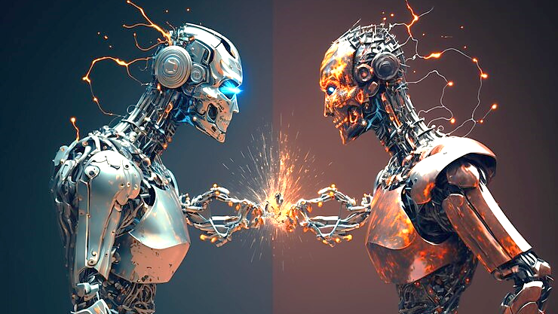
Agenda
Problem Definition.
Problem Solution .
Project Design.
Models .
UI Design.
Tools.
Problem Definition

Slide 4


Problem Definition

Slide 5
Problem Definition
Problem Overview:
Rapid advancements in technology have led to challenges in media authenticity.
Deepfake technology proliferation poses threats in manipulating text, images, and photos.
Addressing challenges in media authenticity due to deepfake technology.
Risks include misinformation, privacy breaches, and malicious intent.

Slide 6
Problem Definition
Challenges:
Need for robust and intelligent detection systems.
Safeguarding against detrimental effects of manipulated media.
Importance:
Understanding implications of unchecked misinformation.
Recognizing potential harm to individuals, organizations, and society.
Project Aim:
Address challenges posed by deepfake technology.
Develop solutions for intelligent detection of manipulated media.

Slide 7
Problem Definition
Significance:
Enhancing media authenticity in the digital landscape.
Contributing to the security of individuals and organizations.
Outcome:
Implementation of effective detection systems.
Mitigation of risks associated with manipulated media.
Conclusion:
Emphasizing the importance of countering misinformation for a secure digital future.

Slide 8

Problem Solution

Slide 9
Project Introduction
Project Overview:
AI Detection System for Multiple Media.
Aims to detect generated in text, images, and deepfake.
State-of-the-art technologies for comprehensive solutions.
Advanced algorithms for image and deepfake analysis.

Slide 10
Project Introduction
Technical Aspects:
Text Detection : Classification of text by detecting LLMs patterns in textual content .
Image Detection: Detect identity fabrication.
Deepfake Recognition: Avoid identity impersonation

Slide 11
Project Introduction
Significance:
Preserving Trust: Enhancing trust in digital media by ensuring authenticity.
Mitigating Harm: Preventing the potential harm caused by misinformation and manipulated content.
Contributing to AI Ethics: Upholding ethical standards in the development and deployment of AI technologies.

Slide 12
Project Introduction
Goals:
Create a powerful detection system.
User Safety: Creating awareness tools to assist users about media manipulation risks.
Multimodal Integration: Integrating analysis across multiple modalities for enhanced accuracy.
Let's delve into the technical aspects and methodologies in the subsequent sections.

Slide 13

Project Design
Use Case Diagram.
Context Diagram.
Data Flow Diagram.
Entity Relationship Diagram.

Slide 14
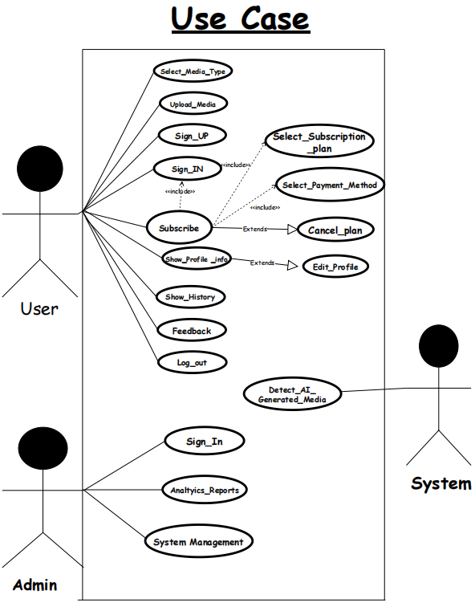
Use Case Diagram

Slide 15
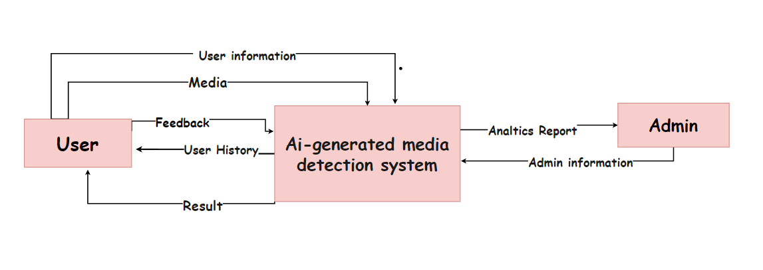
Context Diagram

Slide 16
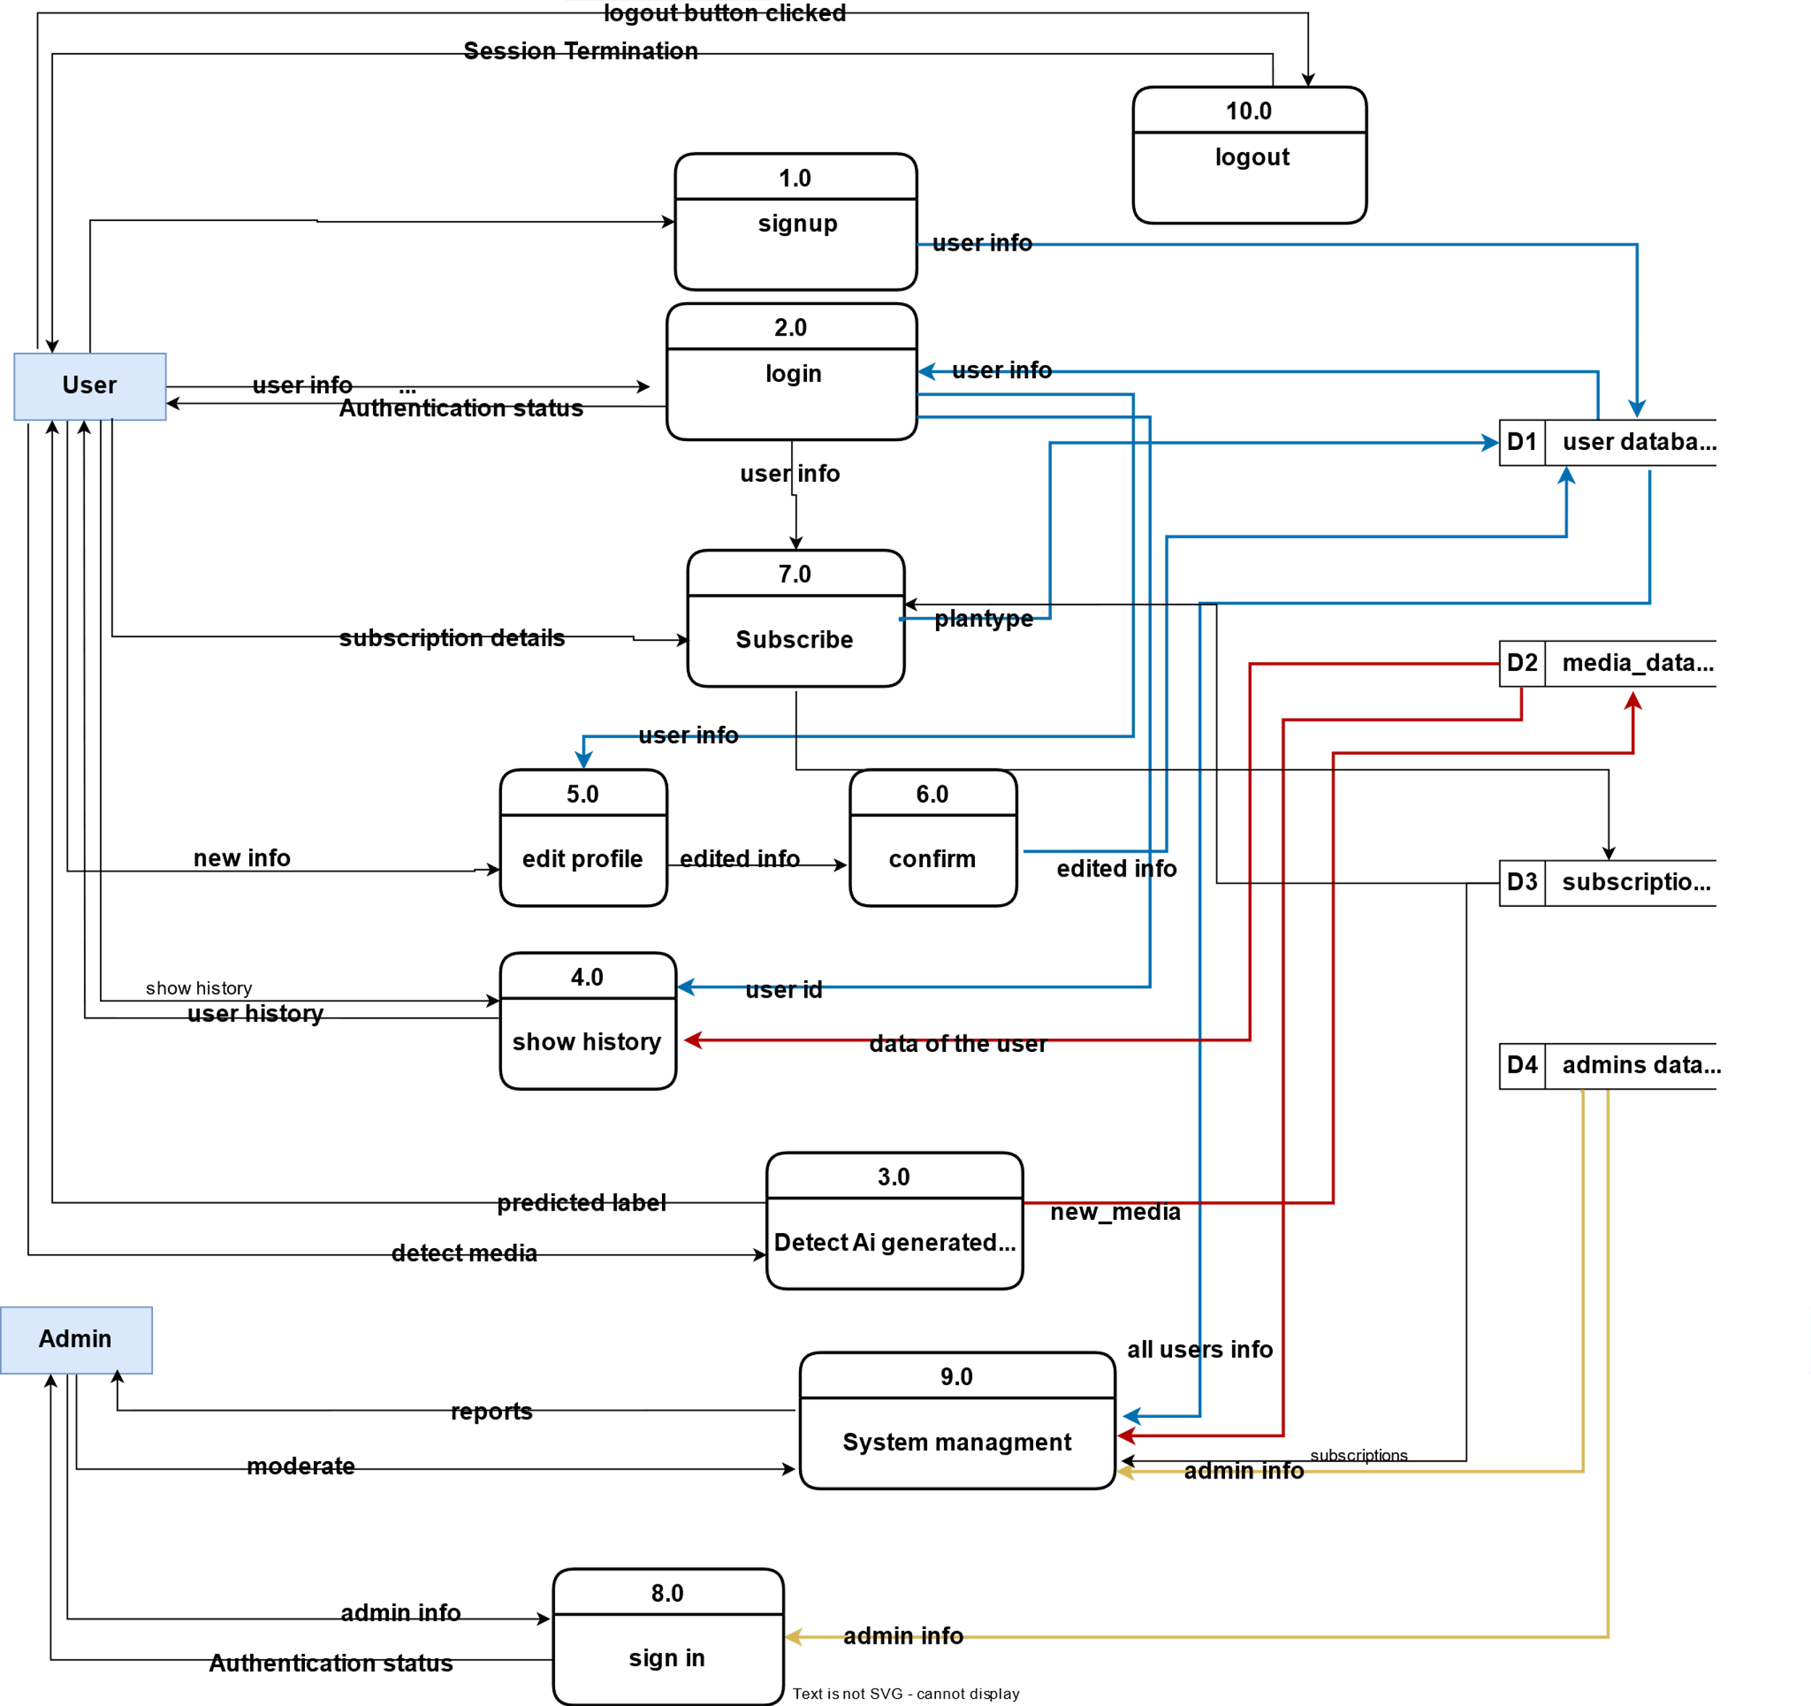
Data Flow Diagram
It is a graphical representation of the flow of data through a system, illustrating how data is input, processed, and output.
data flow diagram contains :
10 Process .
4 Data Stores.
2 External Entity.

Slide 17
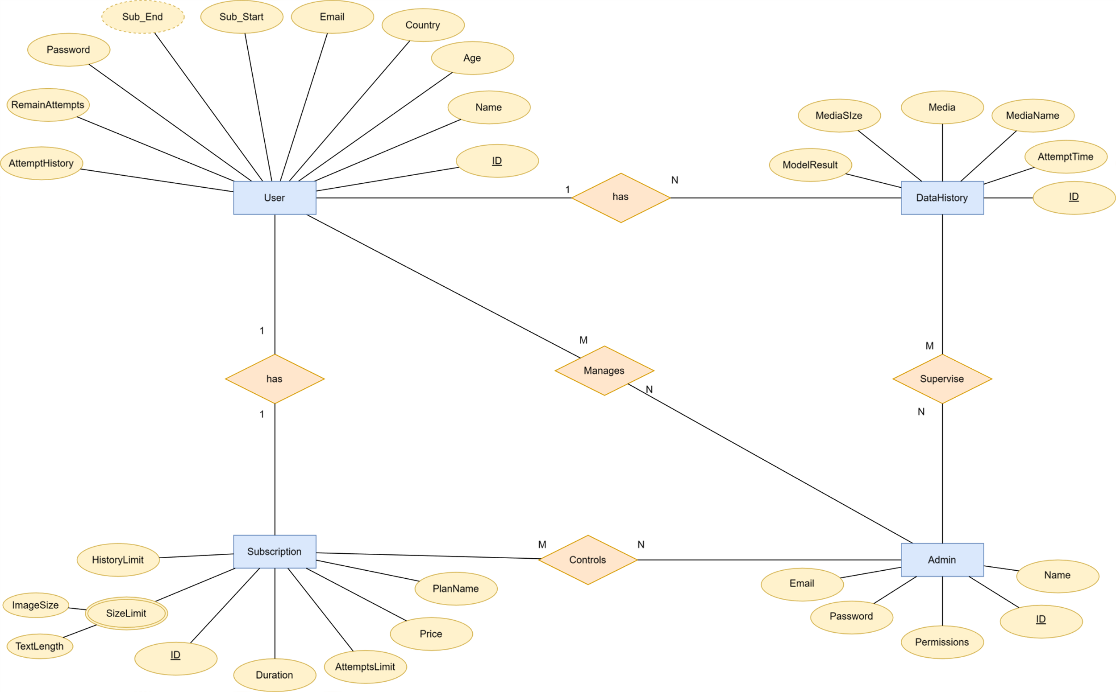
Entity Relationship Diagram
It is a visual representation of the data model that depicts the entities within a system and the relationships between them.
ERD contains 4 entities :
User.
Admin.
Subscription.
Data History.

Slide 18
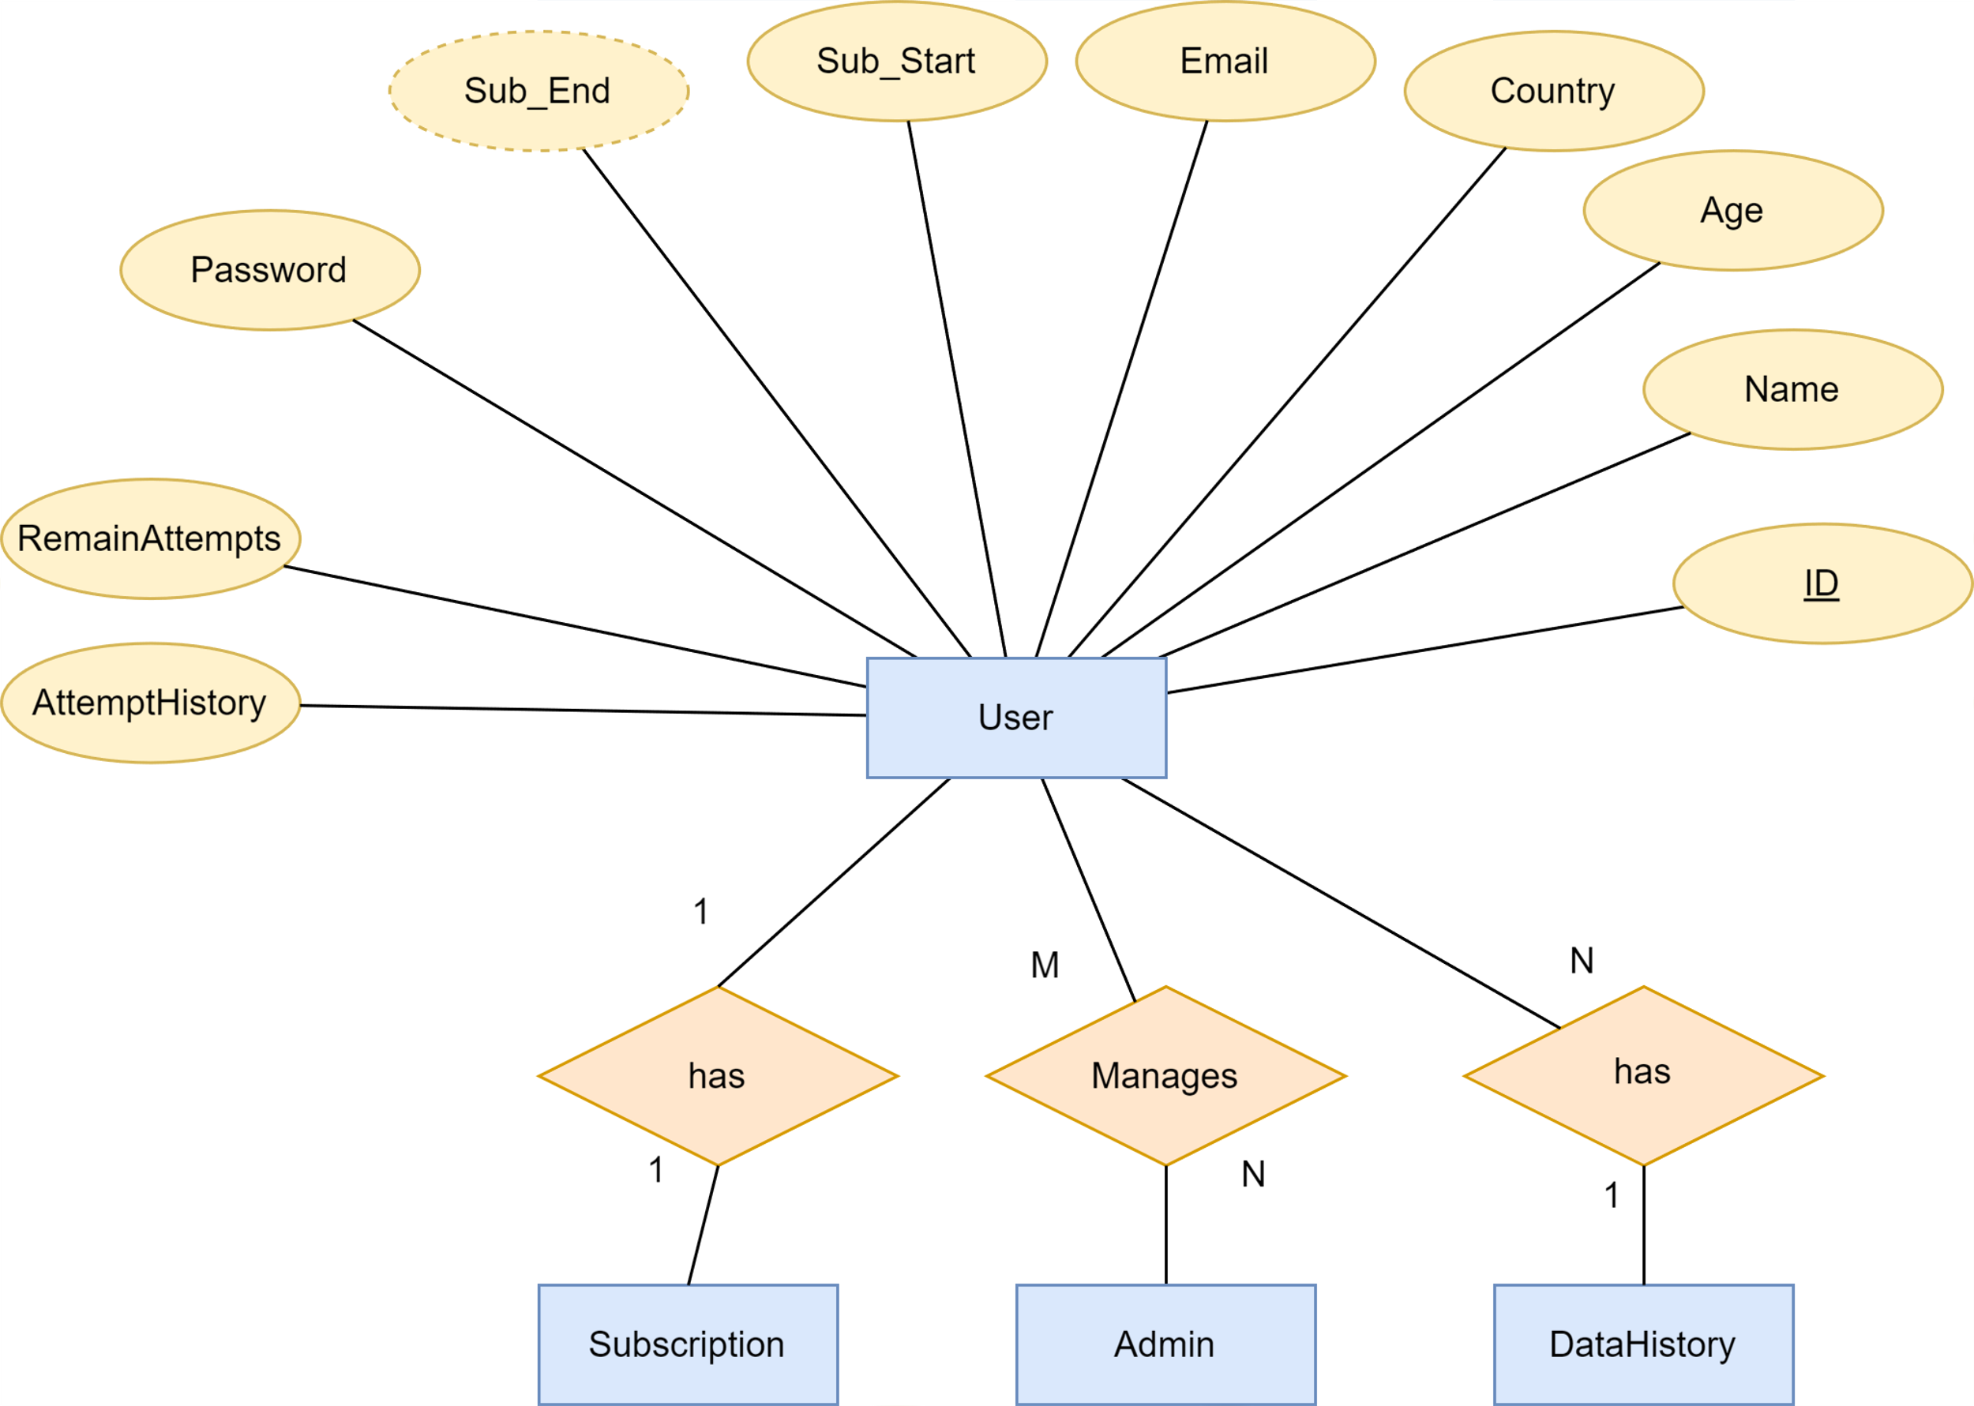
ERD(User)Cont...

Slide 19
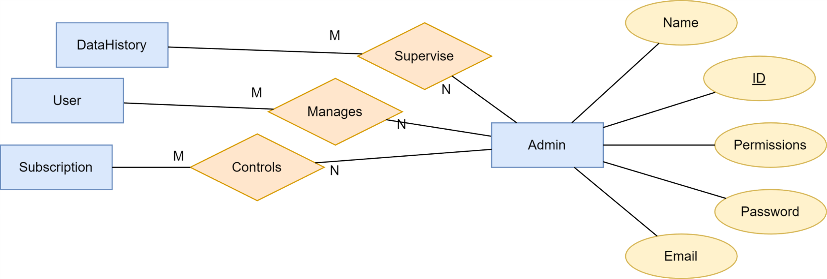
ERD(Admin)Cont...

Slide 20
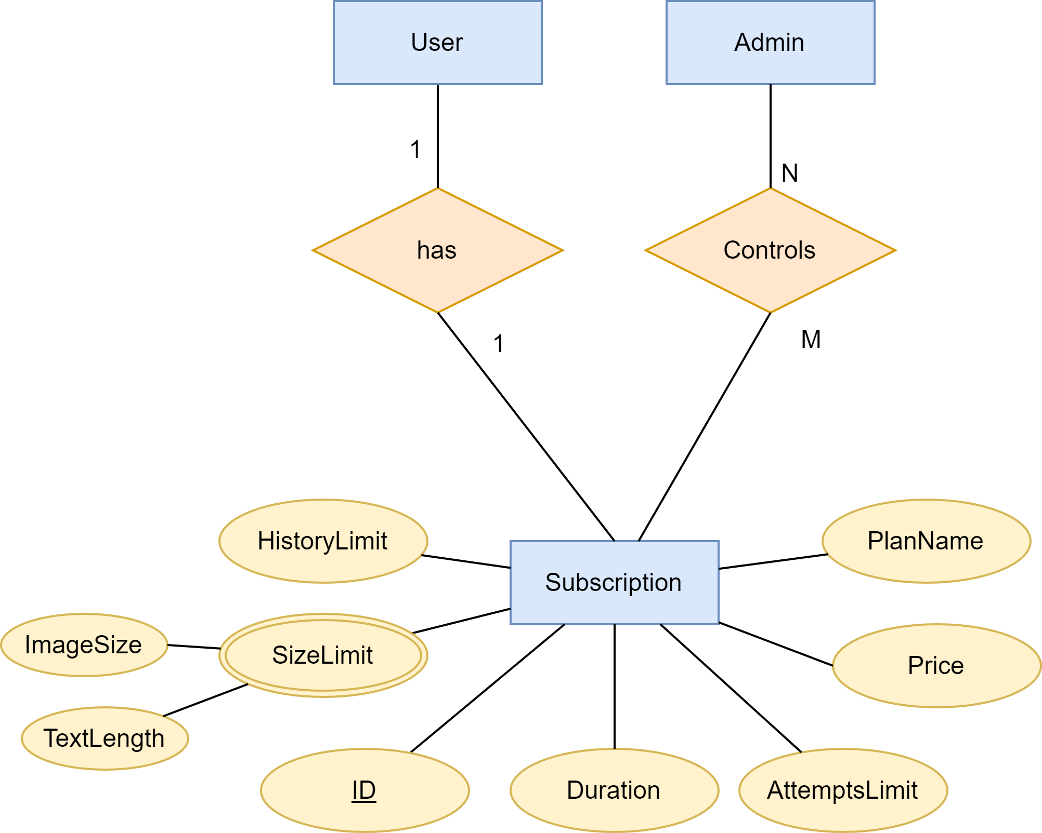
ERD(Subscription)Cont...

Slide 21
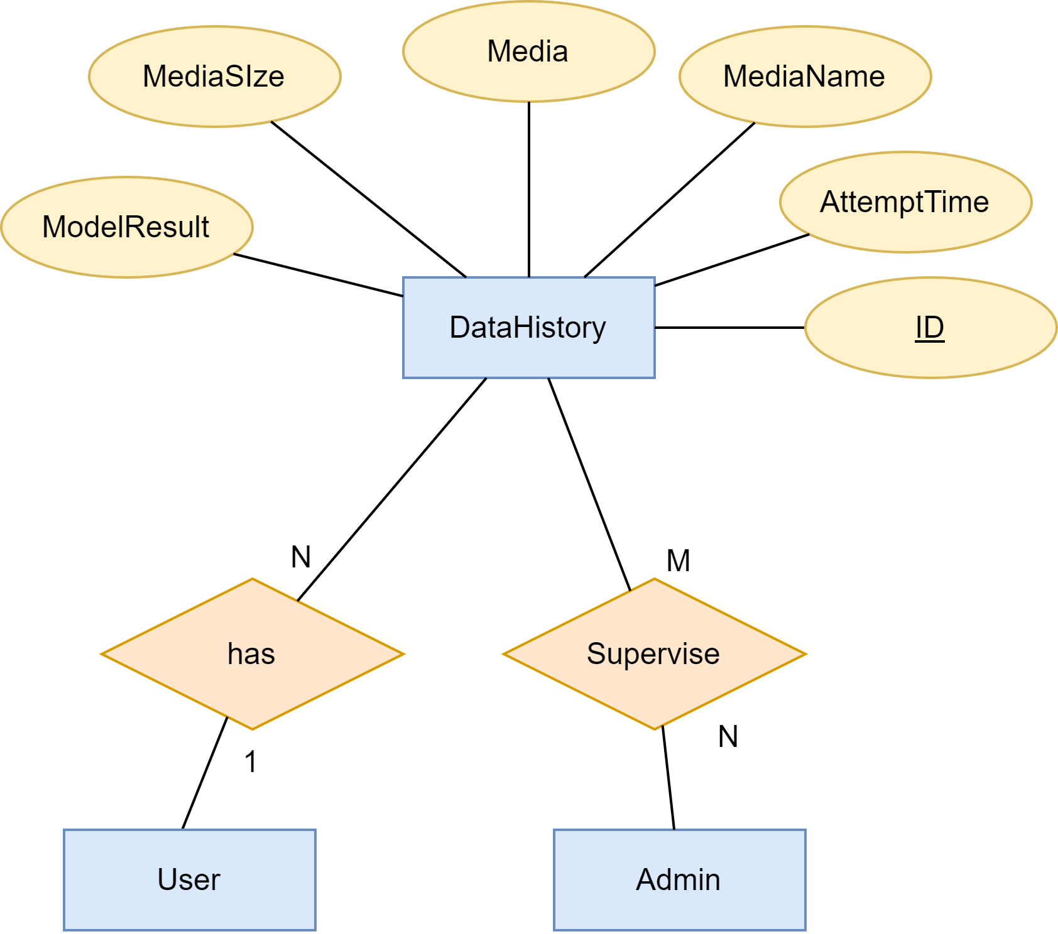
ERD(Data History) Cont...

Slide 22

Models of Detection
Text detector .
Image generated detector .
Deepfake detector.

Slide 23
Text Detection Model
Large language Models (LLMs) can write things that are exactly like what people write, but it is difficult to know whether words come from a person or a machine.
This can be a problem for teachers who are checking whether students have done their own work or used these forms to finish assignments.
A text Detection model is a classification model that separates machine-generated text from human-written ones.
We are trying, using advanced neural network techniques and language models, to build an architecture capable of distinguishing between what was written by an AI and a human.

Slide 24
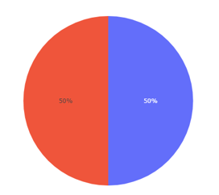
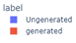
Text Detection Prototype Model
DataSets:
LLM - Detect AI Generated Text : It is a competition dataset comprises about 10,000 essays, some written by students and some generated by a variety of large language models (LLMs). But the number of data available to train the model is 1378 , all of which is written by students.
DAIGT Proper Train Dataset : We used some of this data files to train the model
So we have 19,986 essays, divided into:
9,993 essays by students .
9,993 essays of Text generated by gpt-3.5, Llama and Falcon.

Slide 25
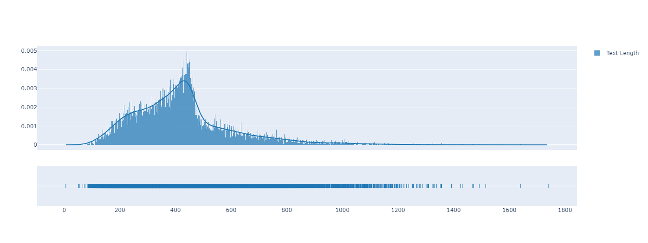
Text Detection Prototype Model(cont…)
This is a distribution of data across text length , from plot:
The Maximum length is 1740
The Minimum length is 6
Most of the lengths are between 427 and 450

Slide 26
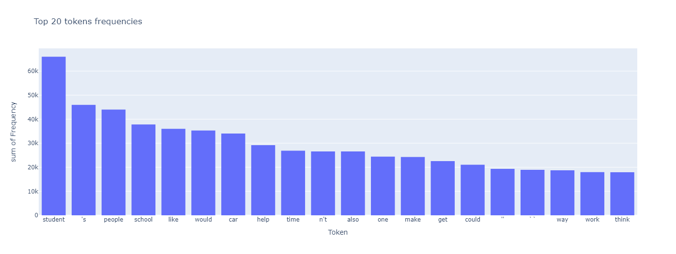
Text Detection Prototype Model(cont…)

Slide 27
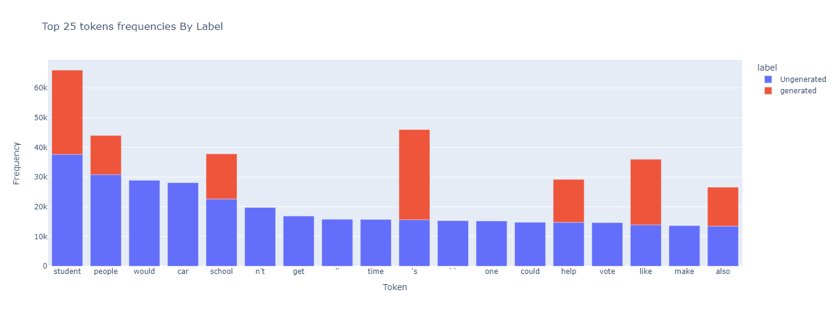
Text Detection Prototype Model(cont…)

Slide 28
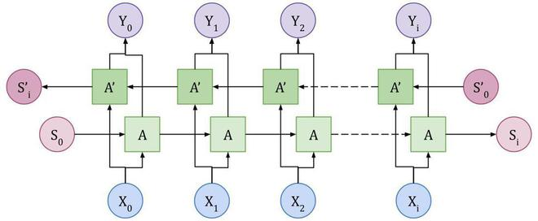
Text Detection Prototype Model(cont…)
A prototype model was created using some deep learning and NLP techniques, including:
LSTM Bidirectional.
Long Short-Term Memory Networks (LSTMs): LSTMs are a specialized type of RNN that are capable of learning long-term dependencies in sequential data. They have been very successful in tasks requiring understanding of context and long-range dependencies.
Bidirectional processing allows the model to capture context from both directions, providing more comprehensive information about the sequence. Bidirectional LSTMs are particularly useful in tasks where understanding the context of a sequence is crucial.
Text Preprocessing: This stage involves cleaning and preparing the text data for further analysis.
Tokenization.
Lowercasing.
Removing punctuation and special characters.
Removing stop words.
Stemming or Lemmatization.

Slide 29
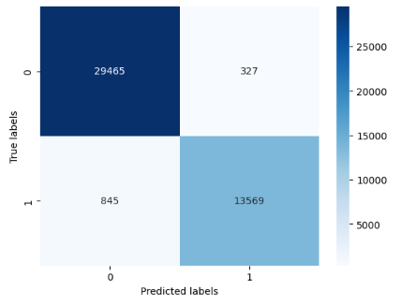
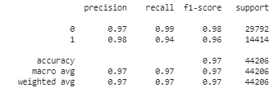
Text Detection Prototype Model(cont…)
Result of model :

Slide 30
Models of Detection
Text detector .
Image generated detector .
Deepfake detector.

Slide 31
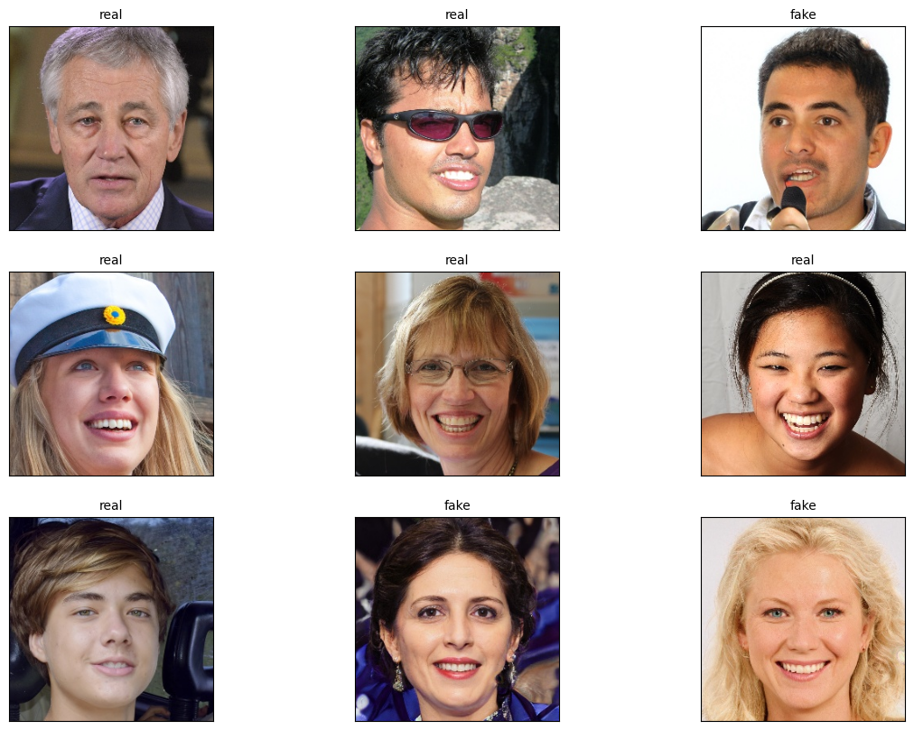
Image generated detector .
About Dataset :
This dataset consists of all 70k REAL faces from the Flickr dataset collected by Nvidia, as well as 70k fake faces sampled from the 1 Million FAKE faces (generated by StyleGAN) that was provided by Bojan.
In this dataset, all the images resized into 256px, data split into train, validation and test set with following :
train: 100,000 images.
validation: 20,000 images.
test : 20,000 images.
we applied some Data Augmentation
and rescaling.

Slide 32
Image generated detector .
About Model:
We used Convolutional Neural Network (CNN) for binary classification to distinguish between Real faces images and AI-generated faces images by other Ai models.
Our model key features:
Input shape: Images of size 256x256 pixels with 3 color channels (RGB).
Model architecture: Sequential model:
consisting 4 convolutional layers followed by max-pooling layers, ending with 2 fully connected layers.
Compilation: Adam optimizer is used with binary cross-entropy loss for binary classification.
Callback: ModelCheckpoint is set to save the best weights based on validation accuracy.

Slide 33
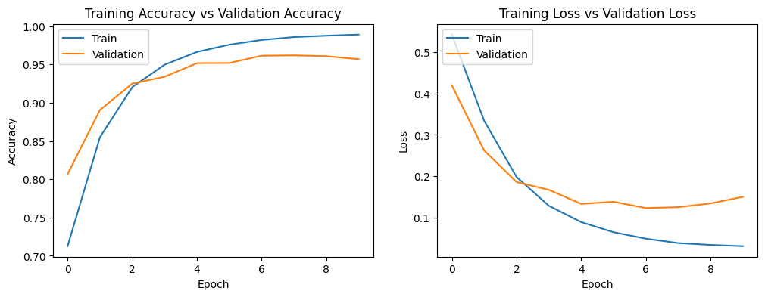
Image generated detector .
Evaluation:
we got accuracy about :
98% on training set.
95% on validation set.
96% on test set

Slide 34
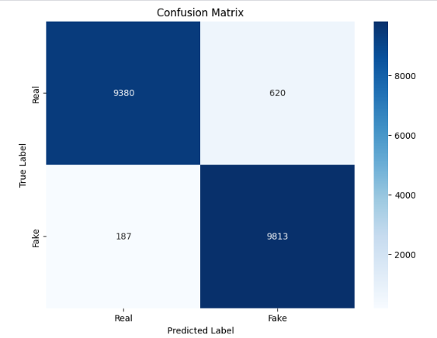
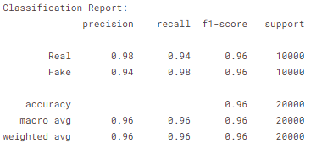
Image generated detector .

Slide 35
Models of Detection
Text detector .
Image generated detector .
Deepfake detector.

Slide 36
Deepfake detector
Introduction
The project addresses the growing ethical concerns surrounding generative AI in the speech domain, specifically focusing on voice cloning and real-time voice conversion. The aim is to develop a robust system for detecting AI-generated speech, mitigating potential privacy breaches and misrepresentation issues.
Dataset - DEEP-VOICE
The DEEP-VOICE dataset is created, featuring real human speech from eight well-known figures and their speech converted using Retrieval-based Voice Conversion.
It is structured as a binary classification problem, distinguishing between real and AI-generated speech.

Slide 37
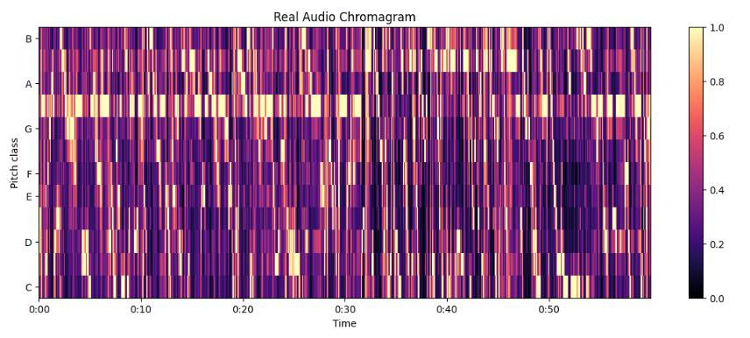
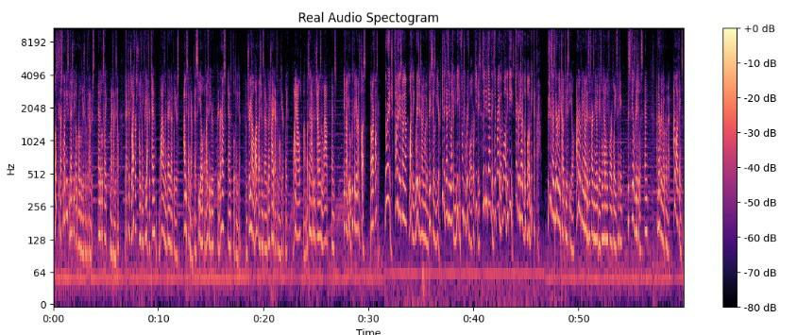
Deepfake detector
Methodology
Statistical analysis of temporal audio features is conducted through t-testing, revealing significantly different distributions between real and AI-generated speech.
Hyperparameter optimization is implemented for machine learning models.

Slide 38
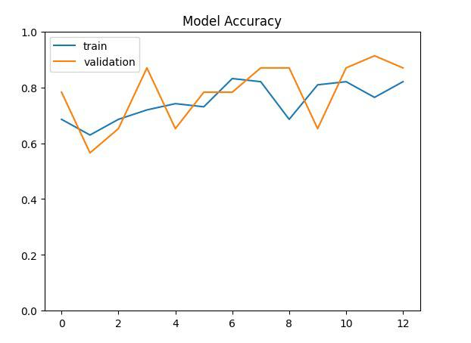
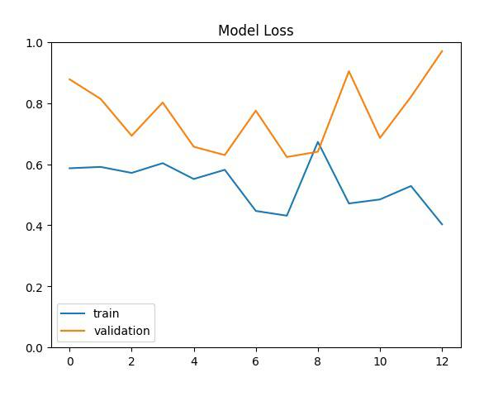
Deepfake detector
Machine Learning Models
208 individual machine learning models are trained using 10-fold cross-validation.
The Extreme Gradient Boosting (XGBoost) model stands out with an impressive average classification accuracy of 99.3%.

Slide 39
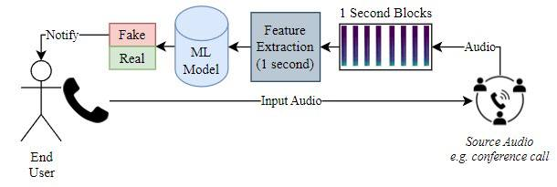
Deepfake detector
Real-Time Classification
The XGBoost model demonstrates the capability to classify speech in real-time, achieving a response time of approximately 0.004 milliseconds for one second of speech.

Slide 40
Deepfake detector
Data Release
All generated data for the study is made publicly available, contributing to future research on AI speech detection.
Conclusion
The project successfully establishes a robust framework for real-time detection of AI-generated speech, addressing ethical concerns and paving the way for further advancements in the field.

Slide 41
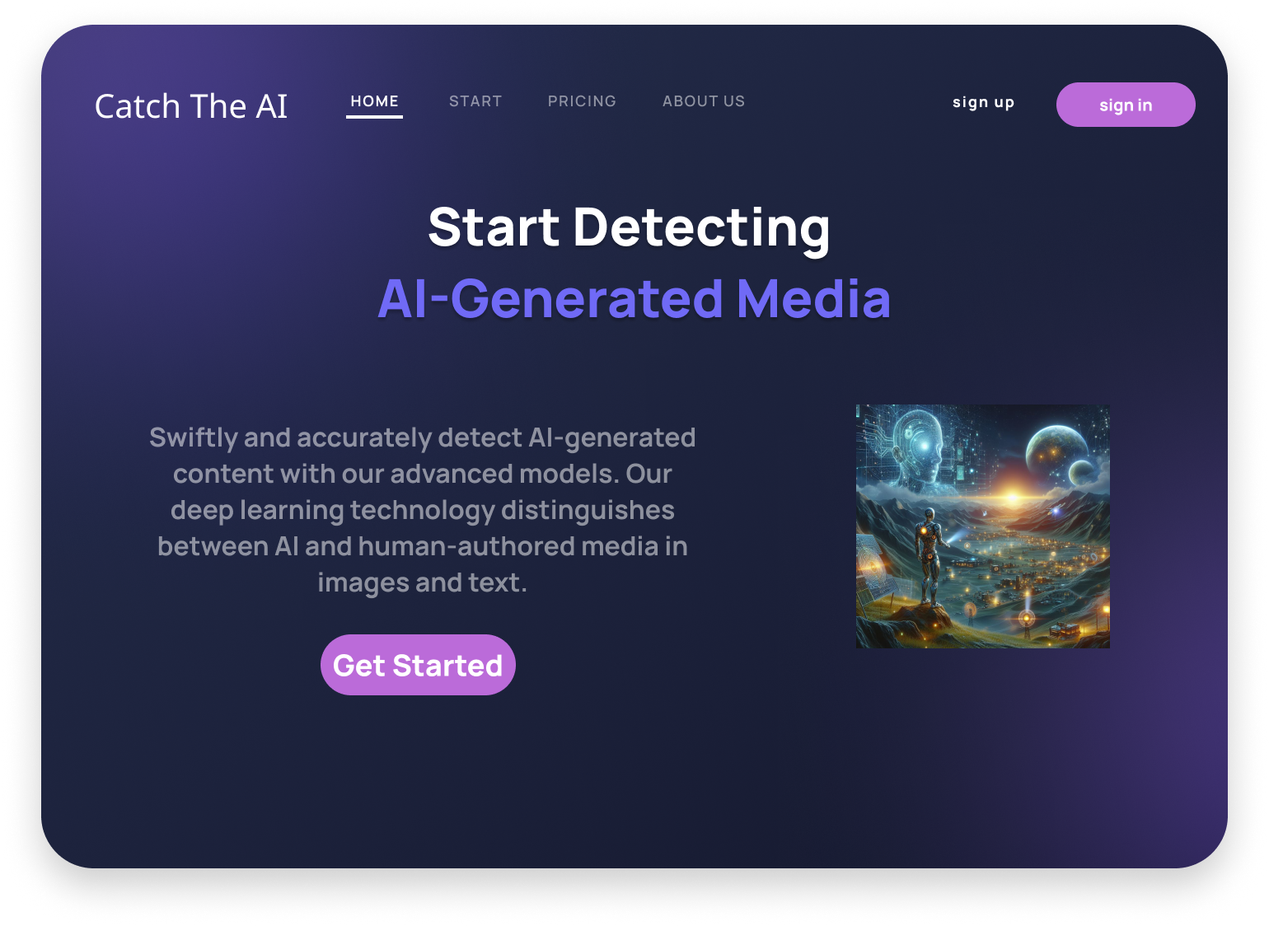
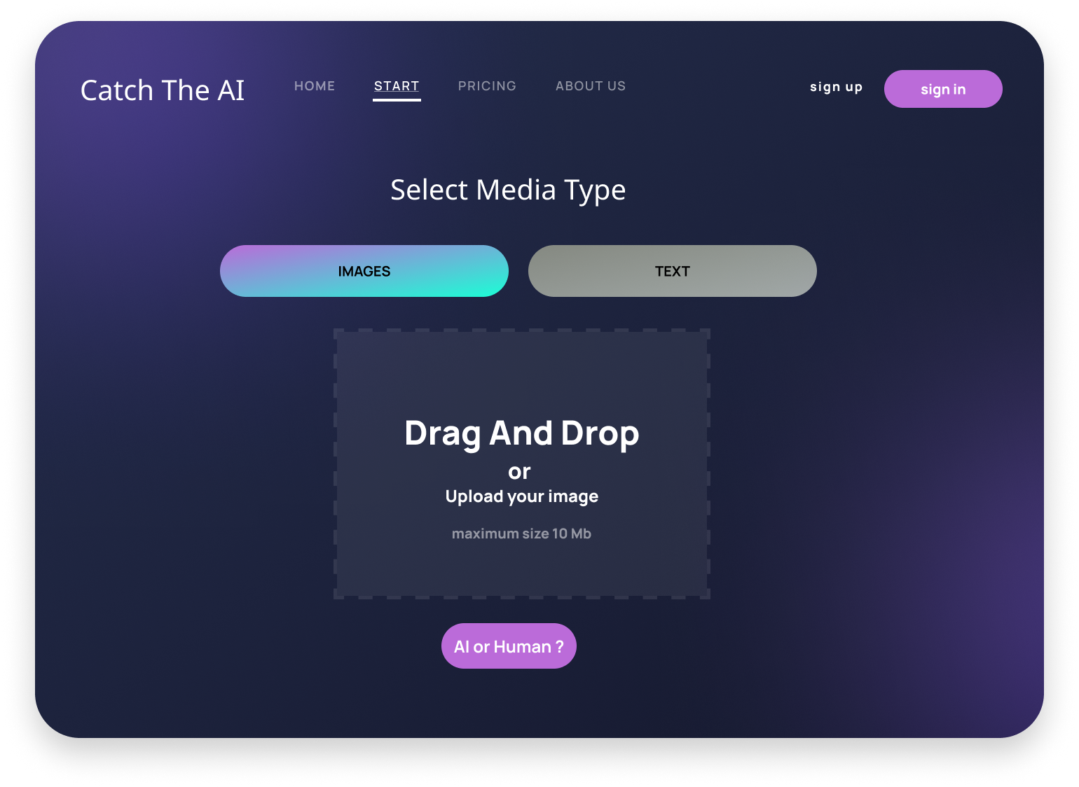



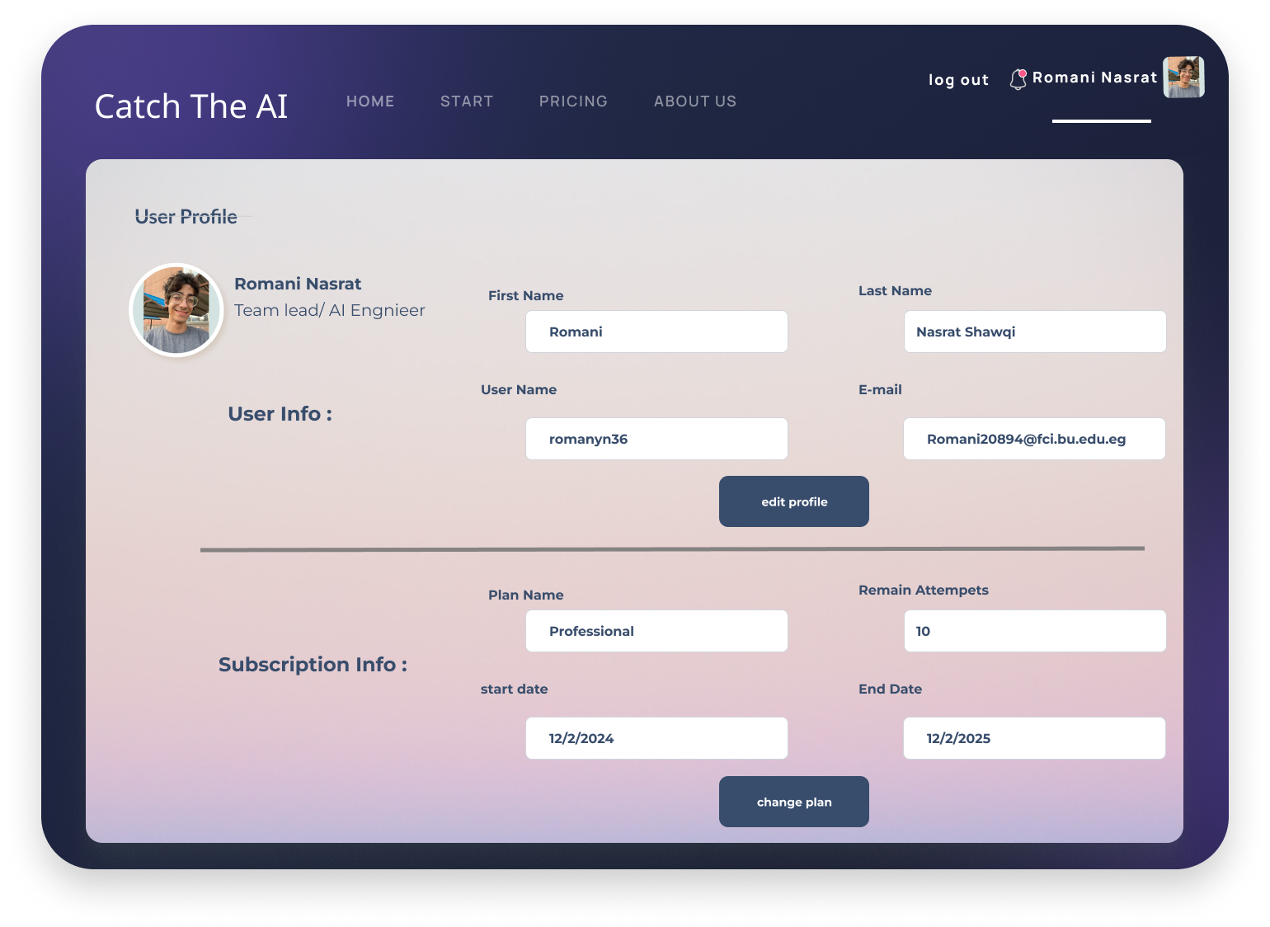

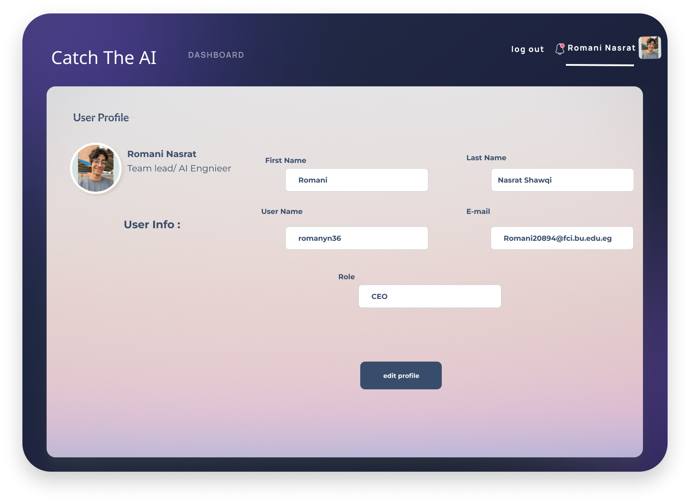
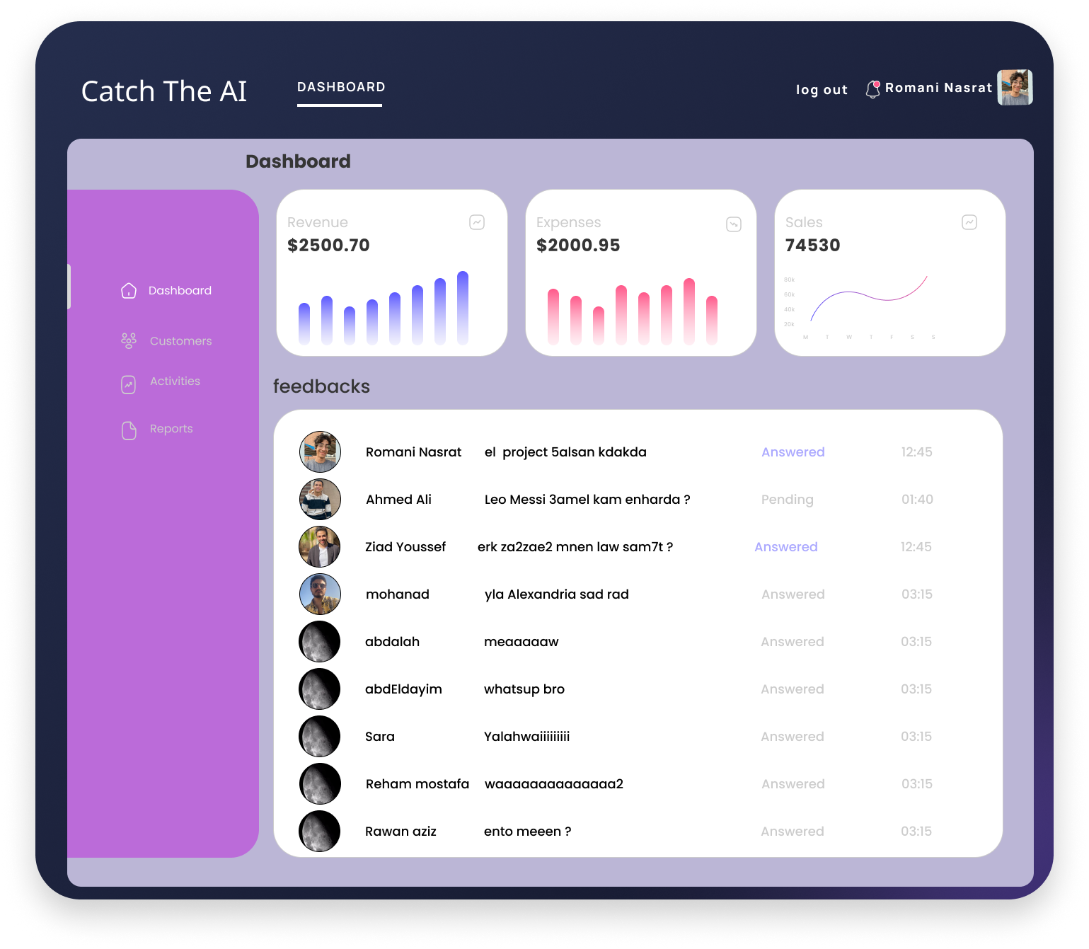
UI Design
Design for web pages

Slide 51
Conclusion
After the journey of developing a robust AI- Generated images, text and speech, we will seek to follow some points towards improving the system and generalize it.
1. Continuous Training and Updating:
Regularly update the system with the latest advancements in AI-generated content. AI models are continually evolving, so keeping the detection algorithms up-to-date is crucial.
Implement a robust training pipeline that includes a diverse set of AI-generated samples to improve the system's adaptability.
2. Multi-Modal Approach:
Integrate multi-modal detection techniques that analyze not only individual types of content (images, text, speech) but also the relationships and consistency across them by combining information from different modalities so it can enhance the accuracy of the system.

Slide 52
Conclusion
3. Behavioral Analysis:
Incorporate behavioral analysis to identify patterns indicative of AI-generated content. This could include examining user interaction patterns, linguistic nuances, or image characteristics that are typical of AI-generated material.
4. Ethical Considerations:
Ensure that the system adheres to ethical guidelines and respects privacy. Strive to strike a balance between improving detection accuracy and maintaining user privacy and freedom of expression.

Slide 53
Conclusion
5. Explainability and Transparency:
Make efforts to enhance the explainability of the detection system. Providing clear reasons for the identification of AI-generated content can build trust and understanding among users and stakeholders.
6. Benchmarking Against State-of-the-Art:
Regularly benchmark the system against state-of-the-art models and detection techniques. This can help identify areas for improvement and ensure the system remains competitive.

Slide 54




Tools

